Slide 1
Kaggle House Price Challenge Team Least Squares

Slide 2
Workflow
Insert Diagram

Slide 3
EDA

Slide 4
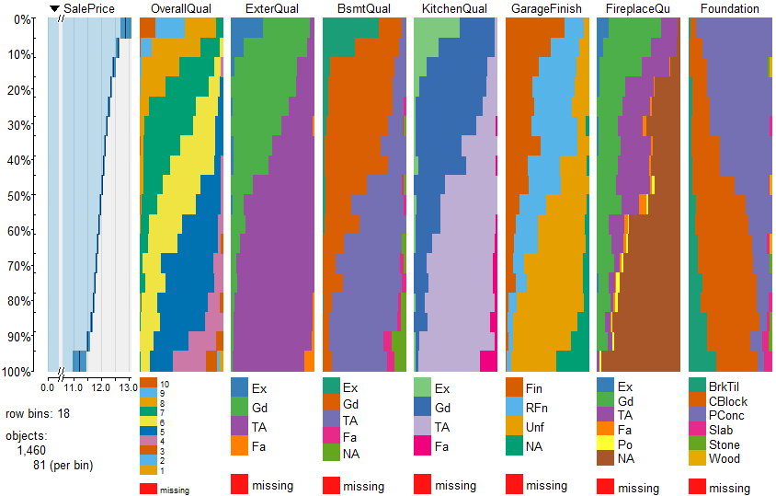
EDA - Categorical Vars

Slide 5
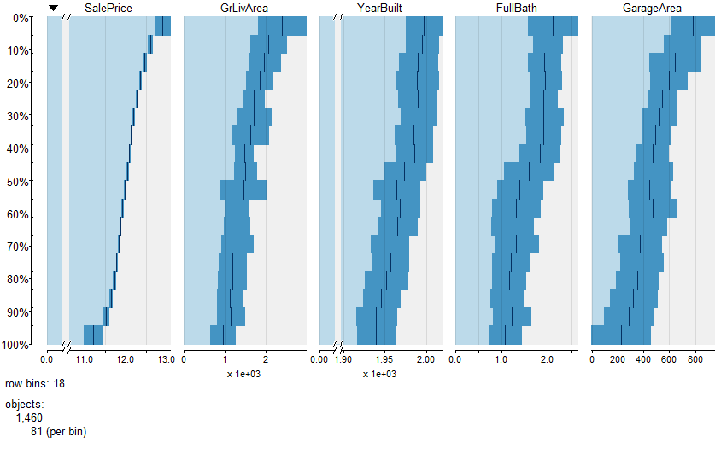
EDA - Continuous Vars

Slide 6
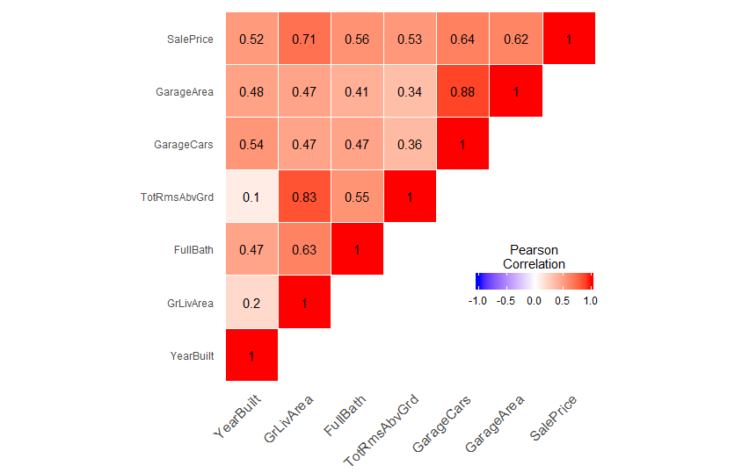
EDA – Correlation Plots

Slide 7
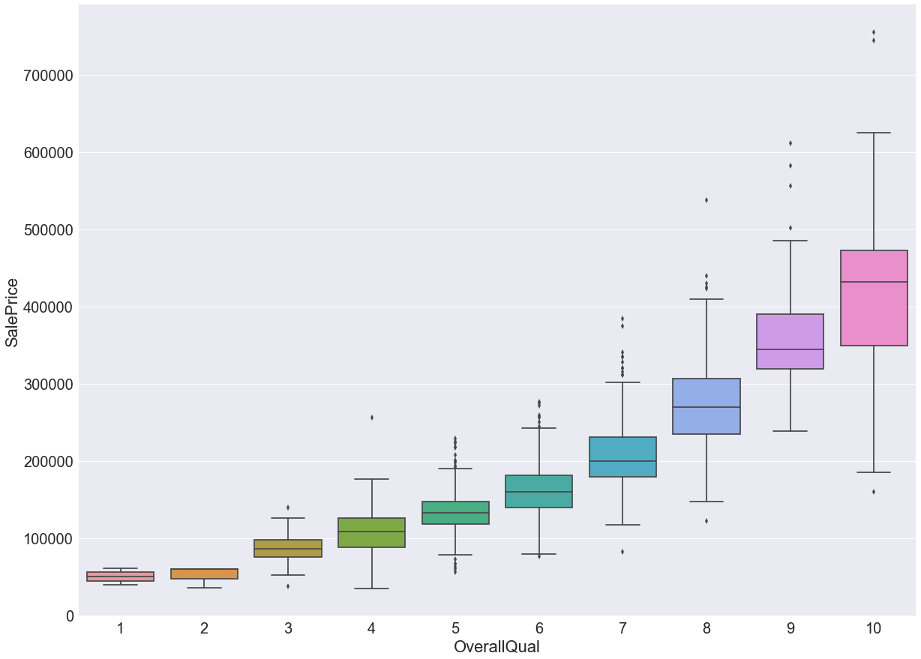
EDA - OverallQual

Slide 8
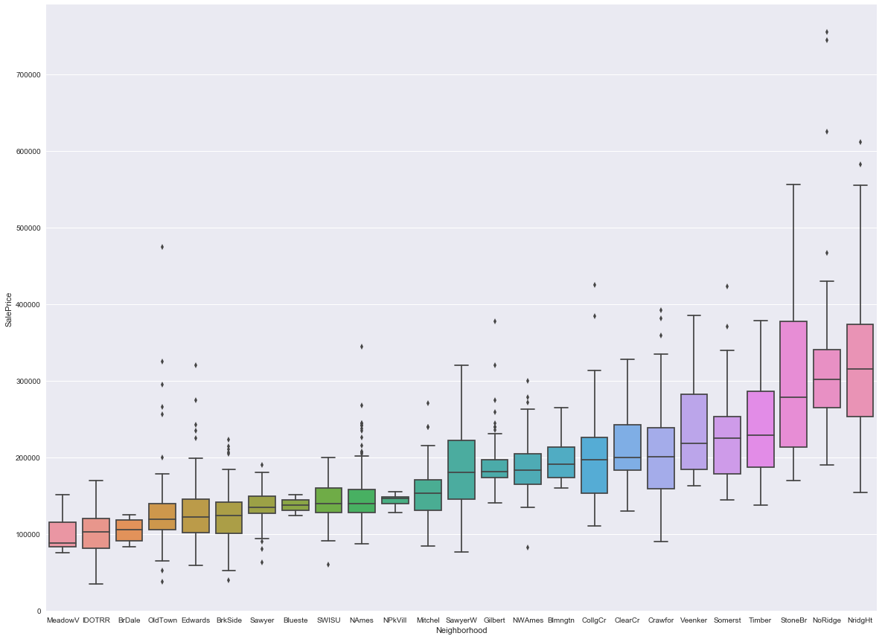
EDA - Neighborhood

Slide 9
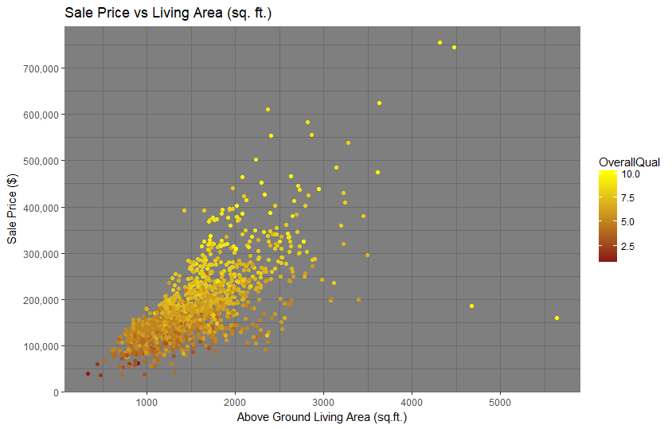
EDA - Scatterplot

Slide 10
Missingness
Categorical
Impute 'None'
Impute with Mode : Electrical
Continuous
Derived Summation Baths, Area
Mean
Median

Slide 11
Imputation
Categorical
Variables
Numerical
Variables
Fill NAs : Mode
MSZoning
Electrical
KitchenQual
SaleType
Fill NAs : Median
LotFrontage
(Neighborhood Median)
Fill NAs : None
PoolQC
MiscFeature
Alley
Fence
BsmtQual
BsmtCond
Fill NAs : 0
BsmtFullBath
GarageCars
GarageArea
MasVnrArea

Slide 12
Feature Engineering
Outliers
Skewness
Scaled
Numerical=>Categorical

Slide 13
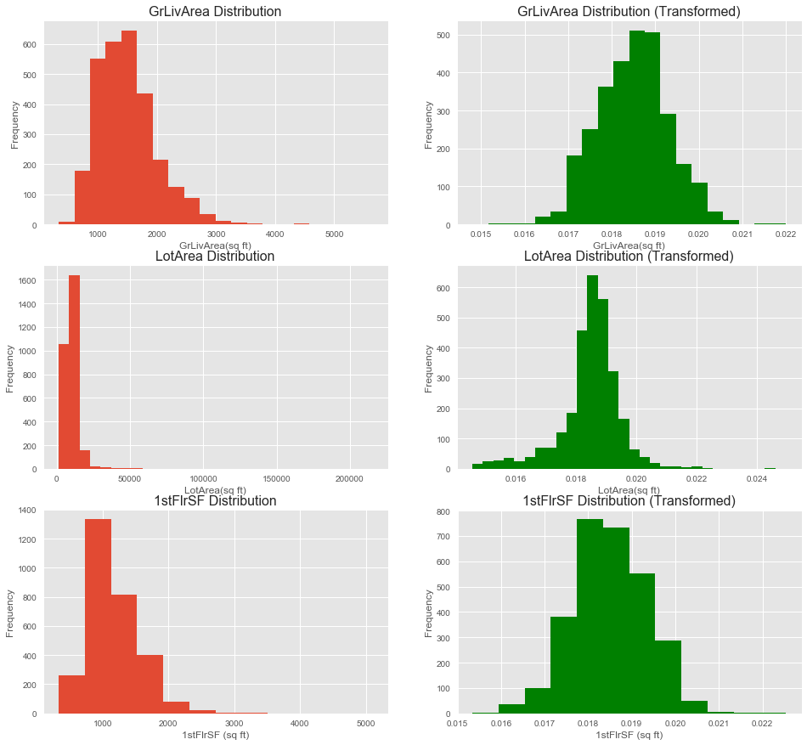
Feature Scaling & Skewness

Slide 14
Linear Models
Multiple Linear Regression
Explored Initial shortlist of 20 Features
Narrowed list to 5 features
Performed Regression
Ridge/Lasso
Explored Interaction of Features
Expanded Shortlist with Interaction Features

Slide 15
Multiple Linear Regression
Shortlist of 20 Features
(Red ones used in Initial Regression)
Location | Style | Condition | Size | Other
Neighborhood | HouseStyle | OverallQual | GrLivArea | SaleCondition
MSZoning | Foundation | OverallCond | 1stFlrSF, 2ndFlrSF | SaleType
 | GarageFinish | YrBuilt | FullBath
 | Paved Drive | ExterQual | TotRms
 |  | BsmtQual | GarageCars
 |  |  | GarageArea

Slide 16
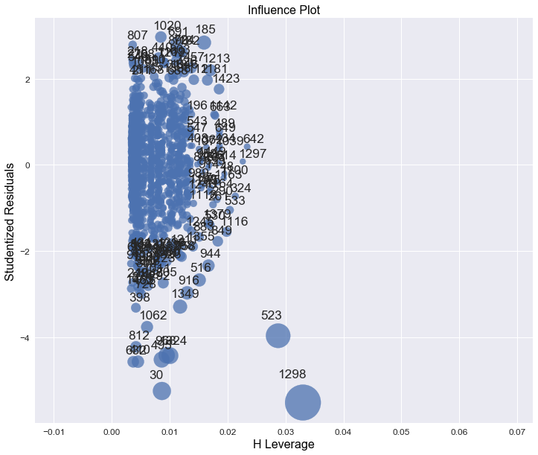
Multiple Linear Regression

Slide 17
Multiple Linear Regression
 | R^2 (Training Set) | RMSE (Training Set)
With Influential Points | 0.800 | 0.178
Without Influential Points | 0.807 | 0.176

Slide 18
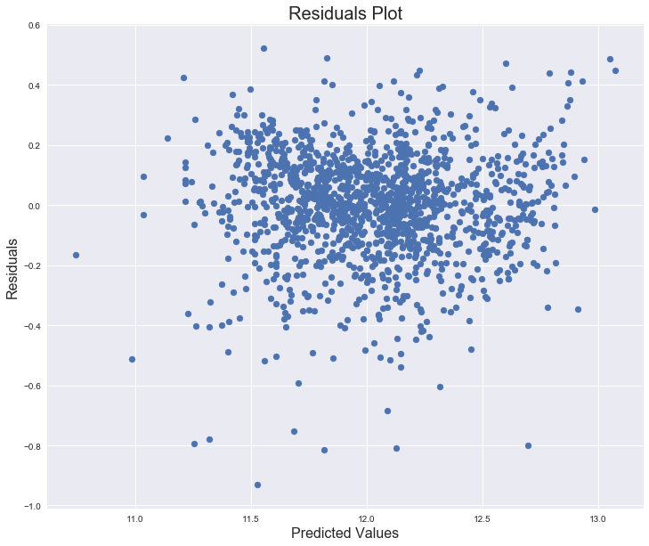
Multiple Linear Regression

Slide 19
Features Interactions

Slide 20
RIDGE/LASSO PROCESS
Split training data 80%/20%
Used grid search to tune hyperparameter
5-fold cross-validation for each parameter value
Tested against remaining 20%
Trained against entire 100% of training set

Slide 21
Ridge Regression
INSERT CROSS-VALIDATION CURVE

Slide 22
Ridge Regression
 | R^2 (Training Set) | RMSE (Training Set)
SUB-TRAINING SET
TEST SET
TOTAL TRAINING SET

Slide 23
Ridge Regression
Top Features | Coefficient Value

Slide 24
Ridge Regression
INSERT RESIDUALS PLOT?

Slide 25
Lasso Regression
 | R^2 (Training Set) | RMSE (Training Set)
SUB-TRAINING SET
TEST SET
TOTAL TRAINING SET

Slide 26
Lasso Regression
Top Features | Coefficient Value

Slide 27
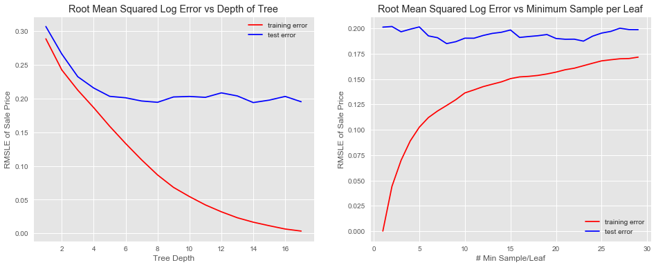
Decision Trees

Slide 28
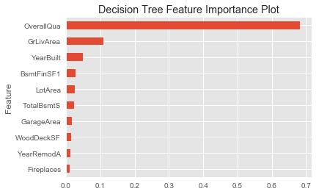
Decision Trees

Slide 29
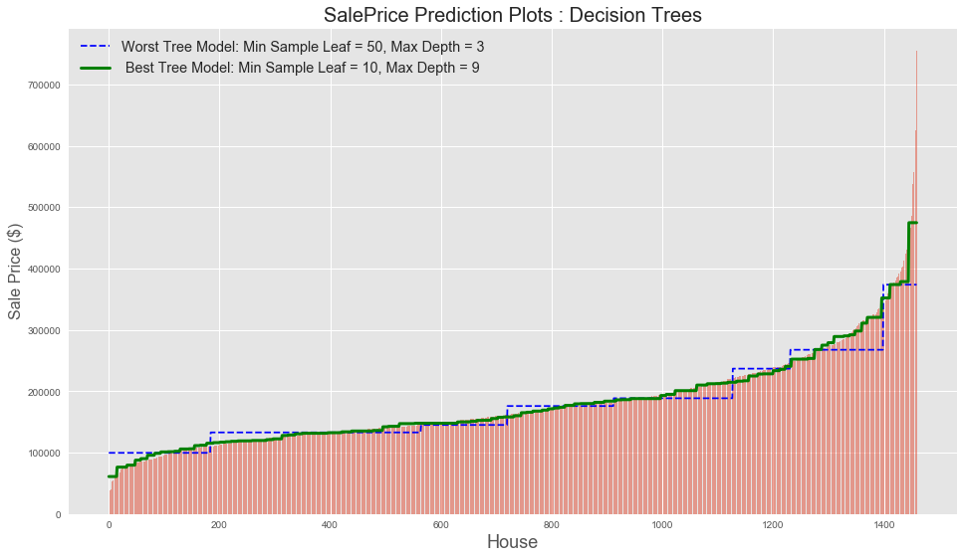
Decision Trees

Slide 30
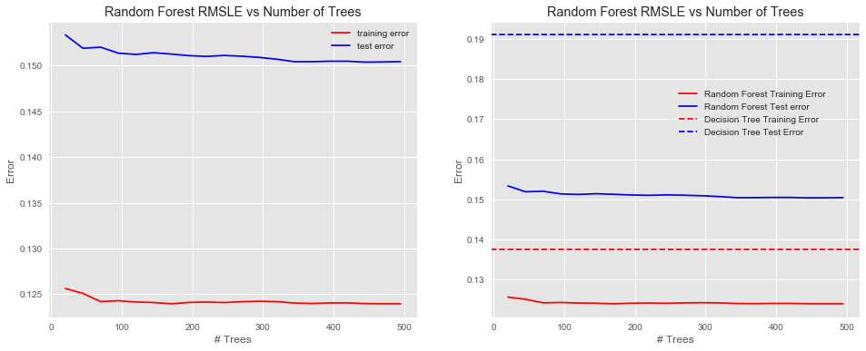
Random Forest

Slide 31
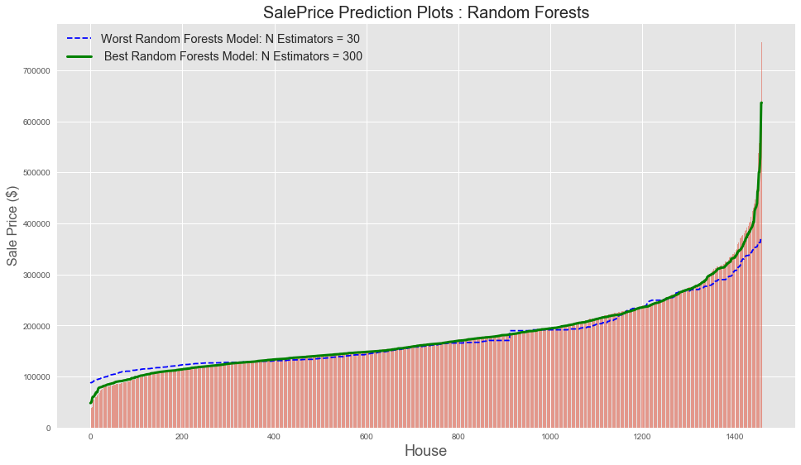
Random Forests

Slide 32
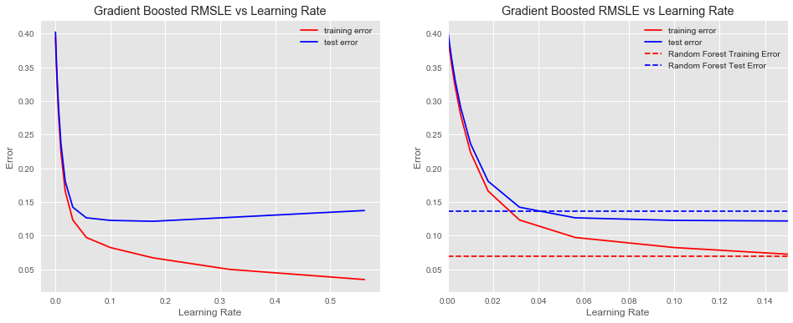
Gradient Boosting

Slide 33
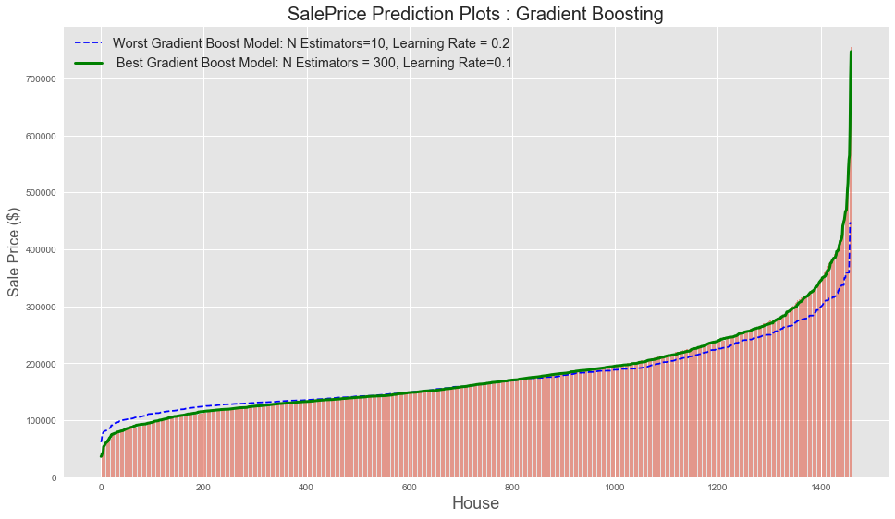
Gradient Boosting

Slide 34
Tree Based Models
CV Grid Search

Slide 35
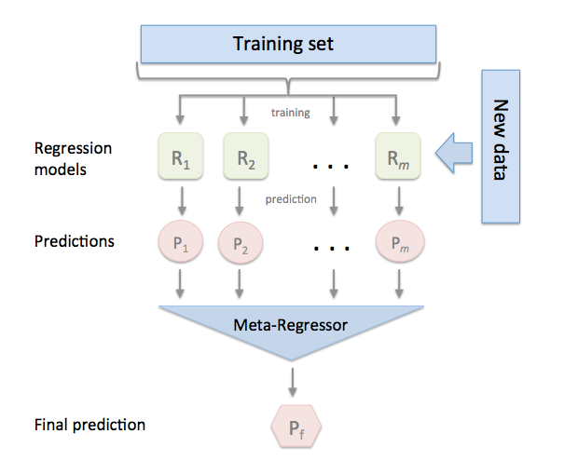
Ensemble Model
Stacking Regressor
Ridge Regression
Lasso Regression
Random Forests
[ Package MLXTEND ]

Slide 36
Ensemble Model Results

